Slide 1




SMART INDIA HACKATHON 2026
AGRO NEON
Explainable AI Powered Smart Farming Ecosystem
Tagline : One AI Companion for Every Farmer – From Soil to Sale
Problem Statement ID : SIHI018
Problem Statement : Smart Crop Advisory System for Small and Marginal Farmers
Theme : Agriculture, FoodTech & Rural
Category : Software
Team Name : TECH NEON

Slide 2


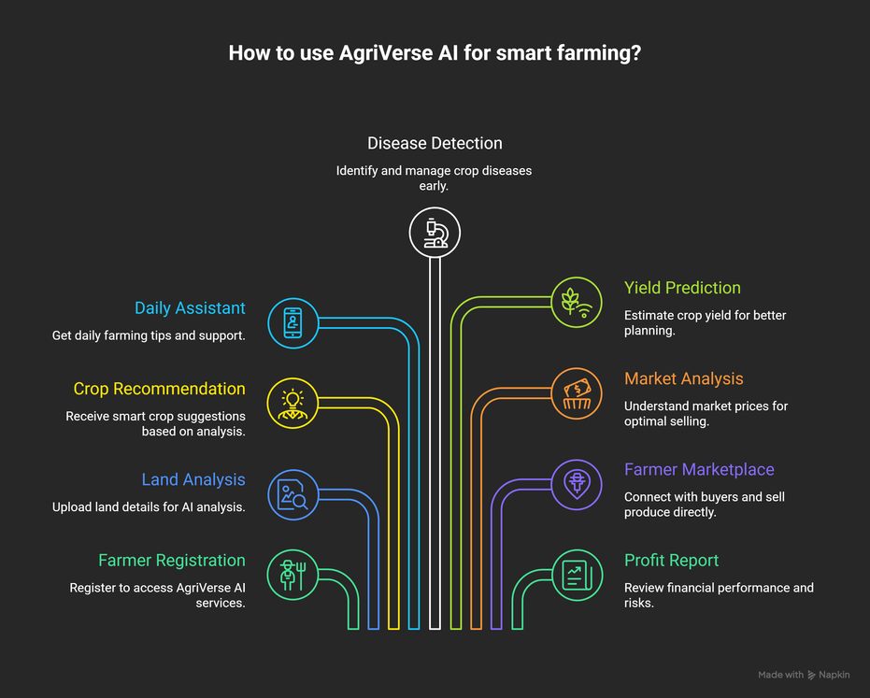
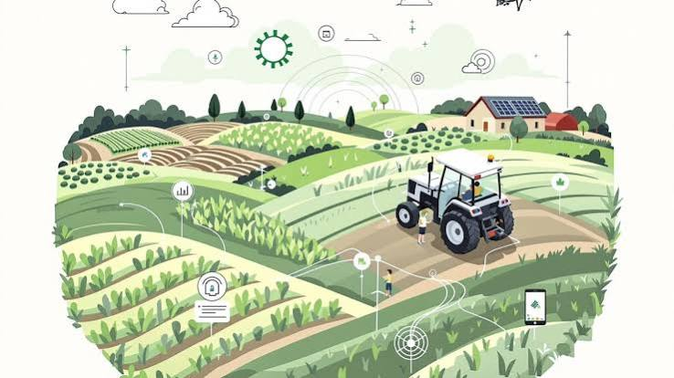
IDEA TITLE
TECH NEON
Transforming Agriculture with Explainable AI
Problem :
Wrong crop selection and poor land productivity
Climate uncertainty & limited advisory access
Crop diseases, price volatility, middlemen exploitation
Lack of scientific, localized guidance for smallholders
Our Solution :
An Explainable AI-powered Digital Farming Assistant providing end-to-end support from land preparation to market, with transparent recommendations and localized interfaces (voice & offline).
Core Features:
AI Land Productivity Analysis & Smart Crop Recommendation
Daily AI Farming Assistant & Voice support (regional languages)
AI Crop Doctor (disease detection) & Yield/Profit Prediction
Market Intelligence, Farmer Marketplace, Offline Mode
Explainable AI: Confidence scores and scientific reasoning
@SIH Idea submission- Template
2
Notes:
2

Slide 3
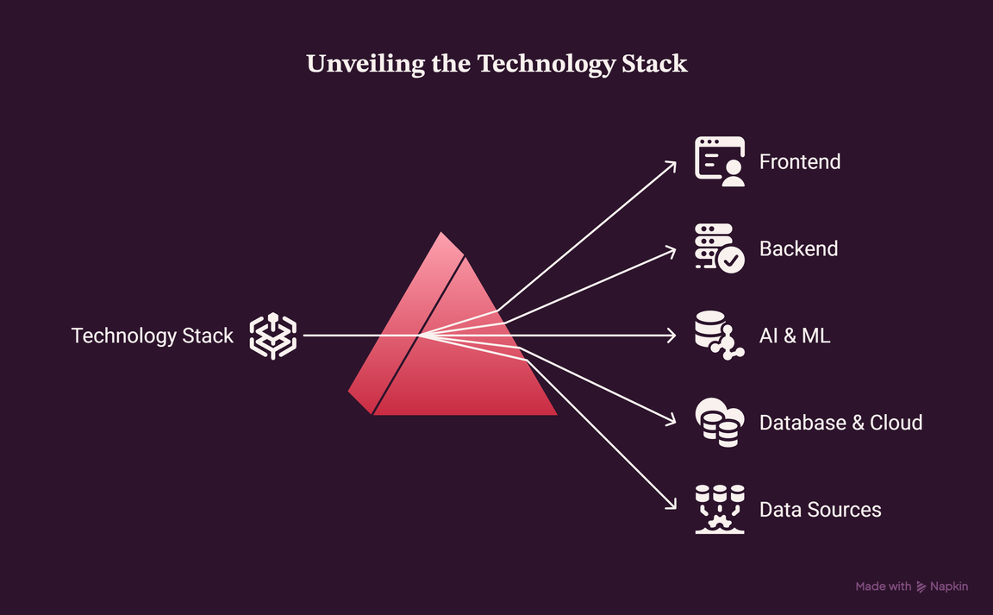
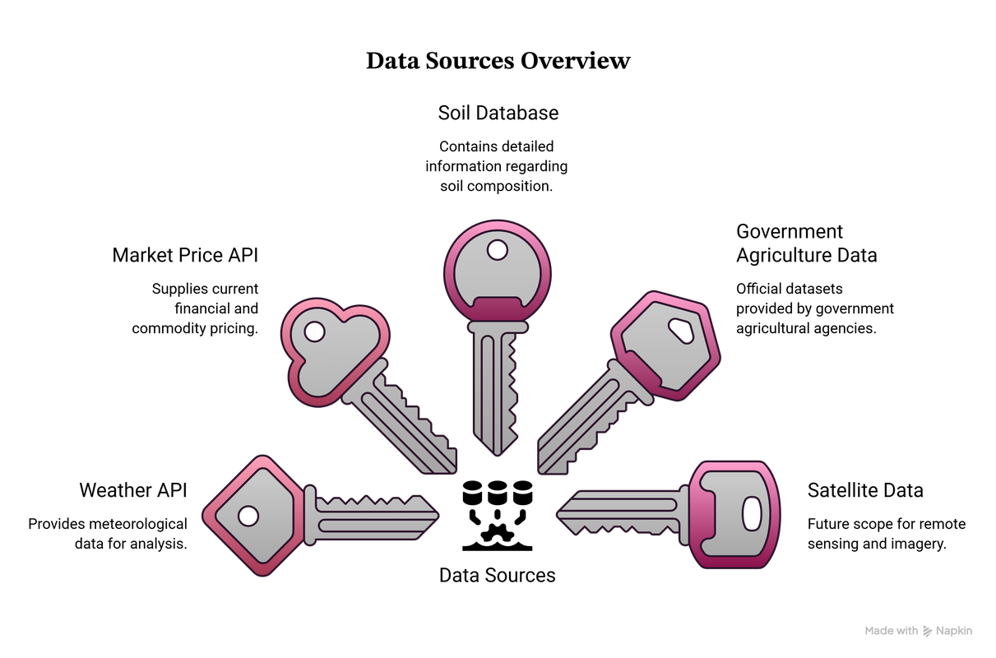
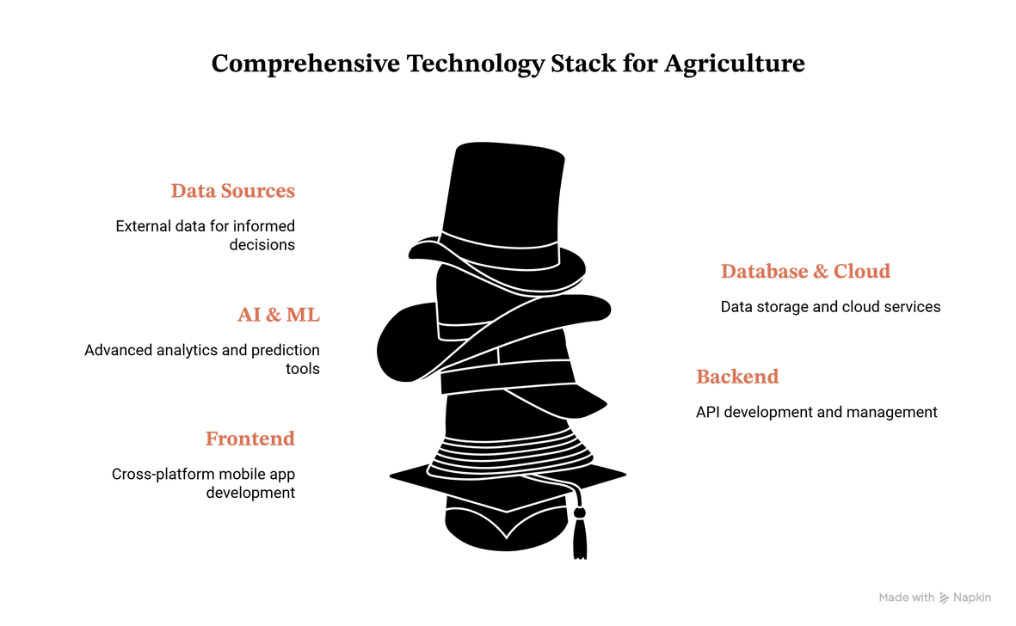
TECHNICAL APPROACH
TECH NEON
Data & Tech Stack
Data Sources : Weather API, Satellite Images, Soil Data, Market Data
Frontend : Flutter · Backend: FastAPI
Database : PostgreSQL, Firebase · AI: TensorFlow, PyTorch, OpenCV
Cloud : AWS CI/CD and containerised deployment
AI Technologies
Computer Vision: EfficientNet, Vision Transformer, YOLO
Machine Learning: XGBoost, Random Forest, LightGBM
AI Chatbot: Large Language Model, Speech Recognition, Text-to-Speech
@SIH Idea submission- Template
3
Notes:
3

Slide 4
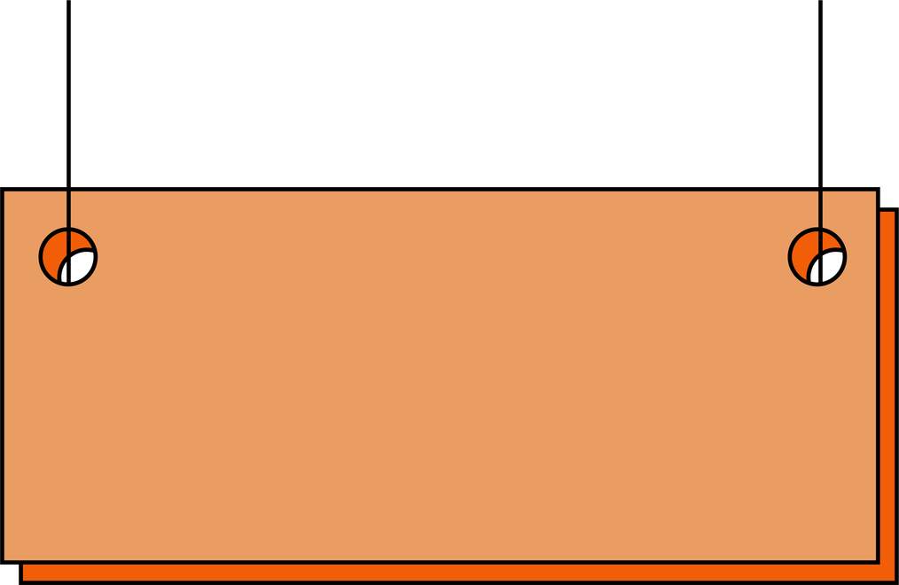
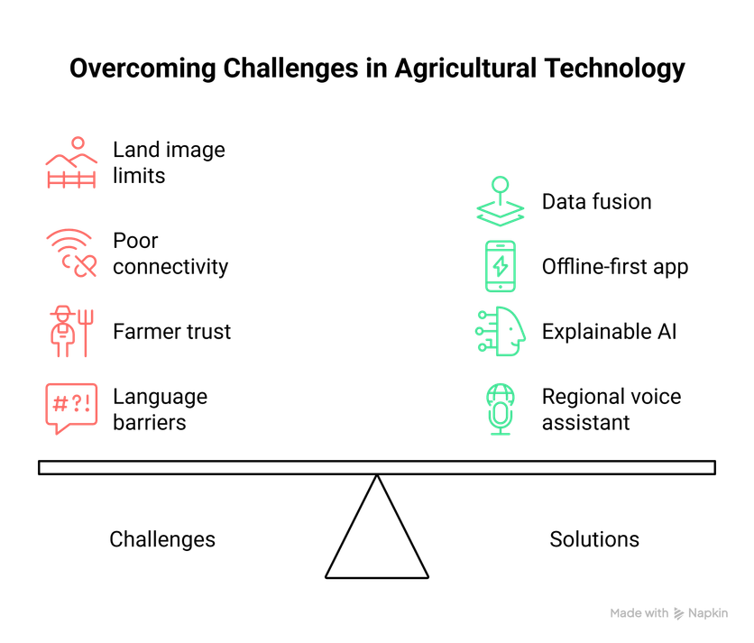
FEASIBILITY AND VIABILITY
TECH NEON
Practical, farmer-friendly deployment using proven AI components and an offline-first mobile experience. Scalable across diverse Indian agro-climates.
Feasibility
Business Viability
Revenue via premium analytics, marketplace commissions, Gov. partnerships, and paid agritech services for FPOs.
Leverages existing CV and ML models, smartphone ubiquity, satellite APIs and government data (Soil Health Card, IMD)
Scalability
Modular services, cloud backend, caching and edge models for offline inference; regional model fine-tuning for local crops.
@SIH Idea submission- Template
4
Notes:
4

Slide 5
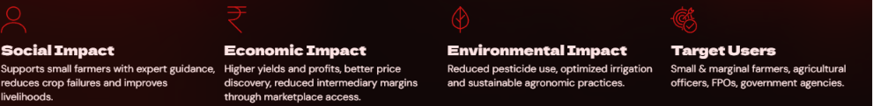
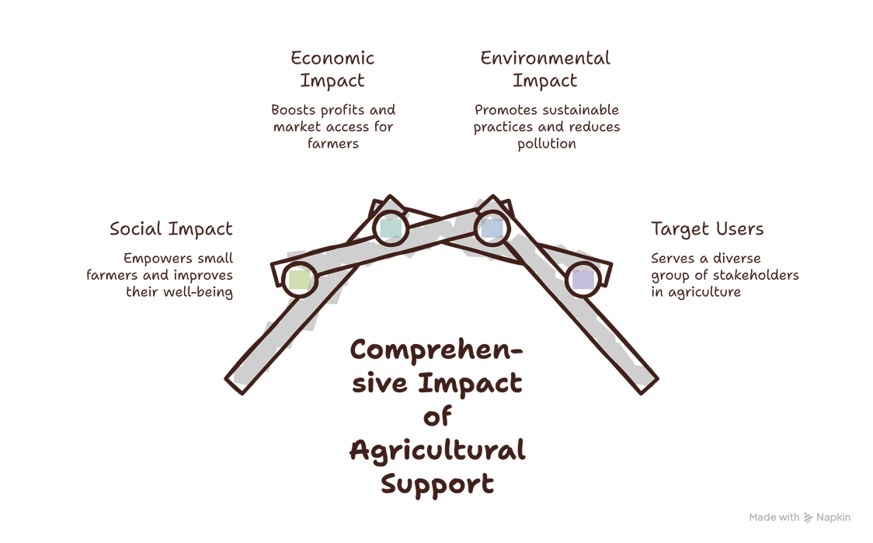
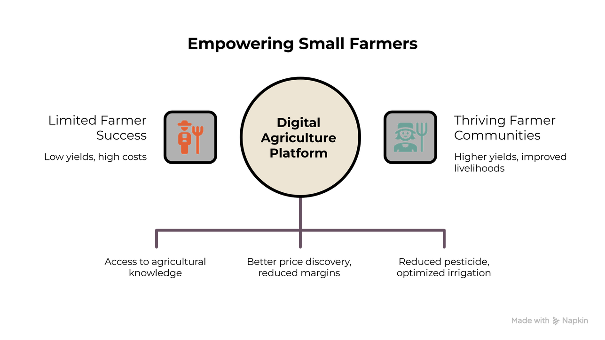
IMPACT AND BENEFITS
TECH NEON
Future scope: Drone integration for precision spraying, IoT soil-moisture sensors, smart irrigation controls, crop insurance integration and alignment with government schemes.
@SIH Idea submission- Template
5
Notes:
5

Slide 6

RESEARCH AND REFERENCES
Your Team Name
TECH NEON
Expected Outcome
Accurate AI crop recommendations with explainability
Daily actionable guidance and disease detection
Real-time market intelligence and farmer-to-buyer marketplace
AI & Data Sources
TensorFlow, PyTorch, OpenCV, YOLO, XGBoost
Weather APIs · Satellite imagery providers · Soil databases · Market price APIs
Agricultural Sources
ICAR
TNAU
IMD
Soil Health Card
Agmarknet
FAO
Future Expansion
🛰 Satellite-based Crop Monitoring
🚁 Drone-based Field Inspection
📡 IoT Soil & Weather Sensors
💧 AI-based Smart Irrigation
🛡 Crop Insurance & Government Scheme Integration
🌱 Sustainable Farming & Carbon Monitoring
@SIH Idea submission- Template
6
Notes:
6

